Slide 1
[insert title]
[insert your location and/or date]
Notes:
Use this cover slide to add your church or organization’s name and location, and add a title for your presentation if applicable.

Slide 2
Heading
Subheading
  Third level text here
Subheading
  Third level text here
Subheading
  Third level text here
Notes:
This slide can be used to add information about your Jobs for Life class including location, dates and times, and what is needed (supplies, volunteers, etc.)

Slide 3

Notes:
The presentation can then transition to discussing the one thing that everyone in the world wants—a good job! A study recently conducted by Gallup found this to be true. Over love, money, food, shelter, safety, peace, and freedom, a majority answered that a “good, full-time job” was what they desired.

Slide 4
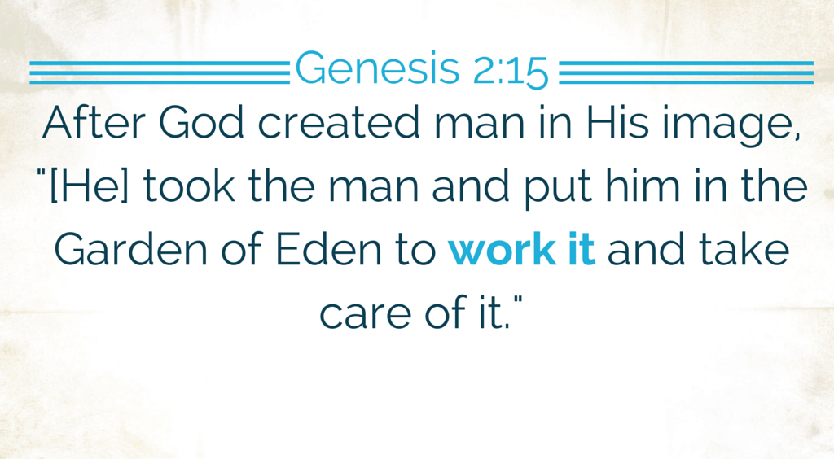
Notes:
God actually created us to work! He gives us all specific talents, gifts, and skills, and wants us to be using them to work for Him and His Kingdom.

Slide 5

Notes:
Sadly, there are many in our world that do not have a good job. Many do not have a job, period. What does this do to people?

Slide 6
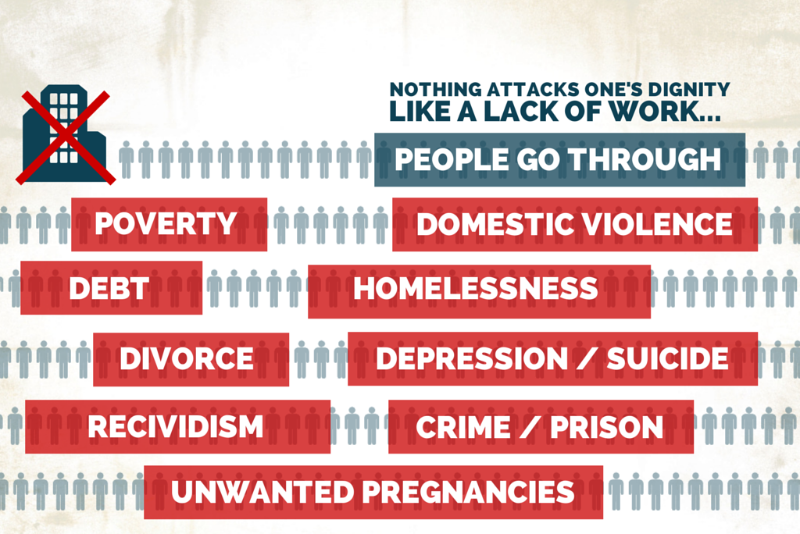
Notes:
The lack of a job leads to many issues. A lack of work attacks one’s dignity like nothing else.

Slide 7

Notes:
Poverty is a global issue. 3 billion people in the world live on less than $2.50/day. There are 46 million people in the U.S. in poverty, which is the most in history. We try to fight poverty by spending money on programs—this year we will pass $1 Trillion on these programs. That’s $80k/year for a family of four! But does this really help solve the problem of poverty?

Slide 8
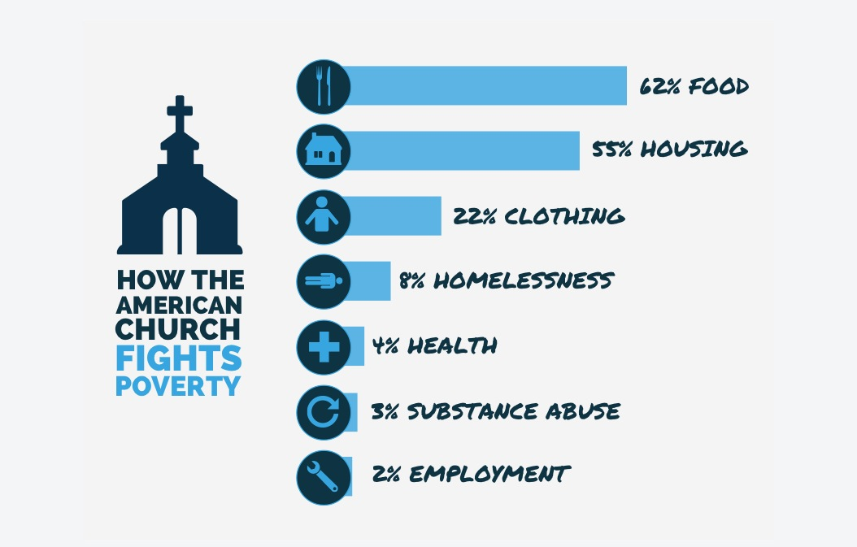
Notes:
For years, the American Church has tried to fight poverty as well. But 62% of churches in this country try to solve the issue by giving out food. 55% help people with housing, and 22% of churches give out clothes. Only 2% of churches in this country help people with employment.

Slide 9
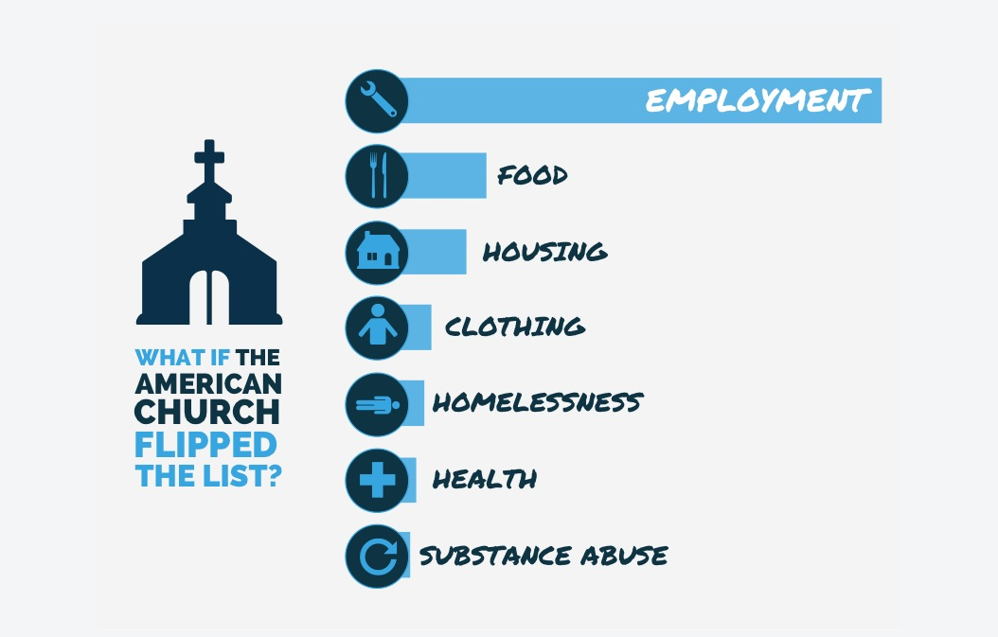
Notes:
So what if we “flipped” this list? What would happen if churches spent their time and resources helping men and women find and keep a job?

Slide 10

Notes:
This is what Jobs for Life aims to accomplish.

Slide 11

Notes:
Jobs for Life’s vision is to see all people living and working for the glory of God.

Slide 12

Notes:
Jobs for Life’s mission is to engage and equip the Local Church to address the impact of joblessness and poverty through the dignity of work.

Slide 13

Notes:
And the answer to the issue of poverty and joblessness is the Local Church. Jobs for Life is a discipleship platform the church, and other Christ-centered organizations, can incorporate into their ministry to help men and women understand the dignity of work and find meaningful employment.

Slide 14
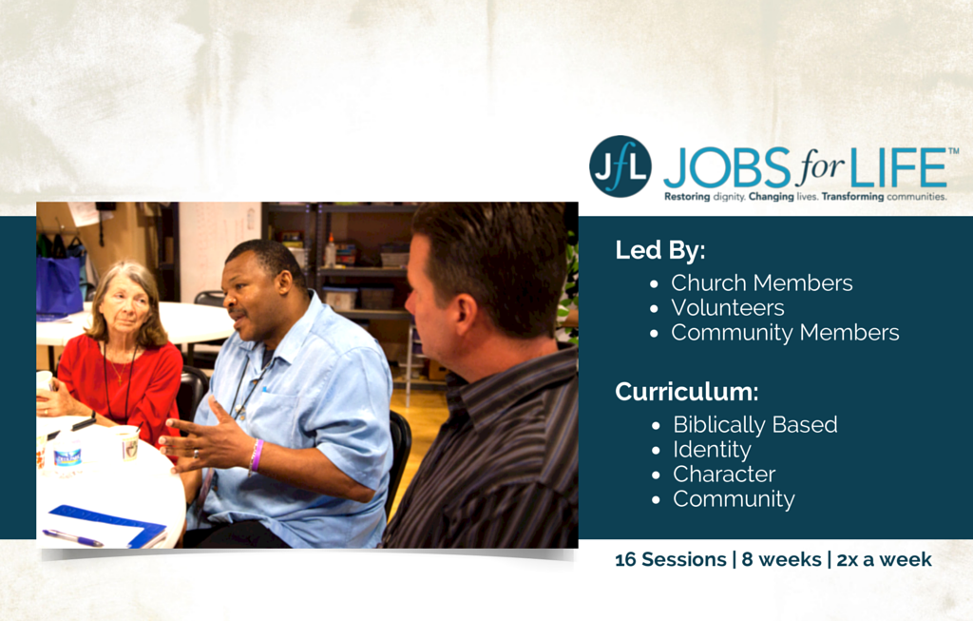
Jfl Class - Pic
Notes:
Jobs for Life classes are led by church members, volunteers, and members of the community. The curriculum taught in the Jobs for Life classes is Biblically-based and focuses on Identity, Character, and Community (which we will discuss later). The class typically last for 8 weeks, with two classes taught per week (16 sessions total). Each class usually lasts for 2-2.5 hours.

Slide 15

Notes:
In the Jobs for Life class, students learn soft skills such as how to write a resumé, how to make a vocational plan, how to conduct yourself in an interview, and how to communicate.

Slide 16

Notes:
But the 3 most important things that students learn in the class are Identity, Character…

Slide 17
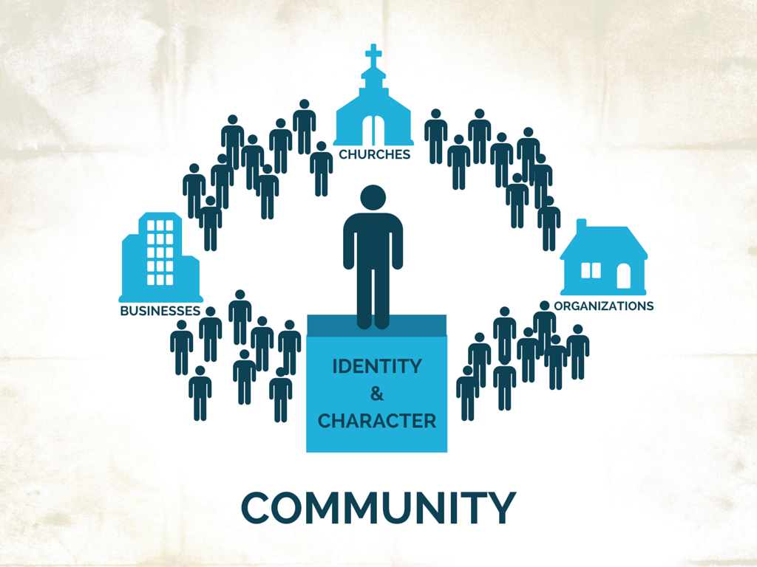
Notes:
…and Community. Members and leaders from churches, organizations, and businesses in the community come alongside students in the class to help them learn more about themselves and what it takes to find and keep a job.

Slide 18

Notes:
Jobs for Life has found that the poverty and joblessness problems are not caused by simply a lack of a job, but by a lack of identity. If you don’t care about yourself, don’t know who you are or why God made you, then it’s very difficult to get a job. You have to first know your identity before you can start trying to find a good job.

Slide 19

Notes:
Secondly, Jobs for Life has found that being ready to work is more about character than skill. Employers, by and large, say that they hire for character—they can train individuals on skills. Character means showing up to work on time, working well with others, being professional in the workplace, and being responsible with your time and tasks. Without character, it’s hard to keep a good job, let alone find one.

Slide 20
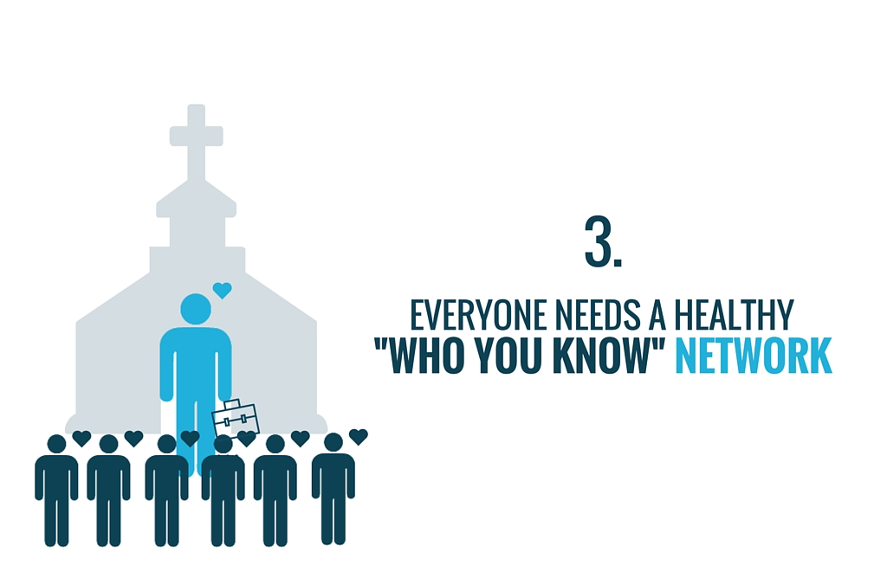
Notes:
And lastly, it takes a community of support. Without a healthy, “who you know” network, it’s very difficult to find a good job. The Jobs for Life class is a platform churches and organizations can use to bring together this community of support and teach men and women identity and character, and the understanding of the dignity of work.

Slide 21

Notes:
Here are just a few examples of students that have graduated from Jobs for Life classes all over the world. The Jobs for Life class is a place where dignity is restored, lives are changed, and communities are transformed.

Slide 22

Notes:
The students in the class are not the only ones impacted however. Volunteers, instructors, and Champions gain a new perspective as well. New friendships are made, barriers are removed, and relationships are reconciled. Men and women discover that it’s not about “us helping them”, it’s about growing and learning together, and allowing God to work.

Slide 23

Notes:
Join a global movement of churches and organizations fighting poverty through the dignity of work and helping men and women find and keep meaningful employment. Join us as we restore work, restore dignity, and flip the list! Visit www.jobsforlife.org for more information on how to get involved.

Slide 24
Heading
Subheading
  Third level text here
Subheading
  Third level text here
Subheading
  Third level text here
Notes:
This closing slide can be used to add information about your Jobs for Life class including location, dates and times, and what is needed (supplies, volunteers, etc.)

